Slide 1
Important Reminders!
In-Class Exercises from last week due today before the end of class
Upload your Word file from Day 1 and your Excel file to the Dropbox
Homework #1 is due tomorrow: Tues, Mar 20 @ 5:00pm
(See submission instructions on myCourses!)
Upload the Excel and Word files to the Dropbox AND put a print-out of your Word document in the drop-off bin by the mail folders

Slide 2
Excel Plotting
Problem Solving w/ Computers
Week 2 (Day 5-6)

Slide 3
Recap: Questions??
Inserting formulas
Copying formulas across cells
Naming cells
Using built in functions
Creating tables

Slide 4
Recap: Questions??
Trigonometric functions in Excel need the angle specified in radians
The “$” symbol placed prior to the column letter fixes the column when the formula is copied.
The “$” symbol placed prior to a row number fixes the row as the formula is copied.
The "$" symbol placed prior to both column and row fixes the cell as the formula is copied

Slide 5
Graphing Basics
Select the data range
Select the Insert tab on the ribbon
Select a chart type to start the “Chart Wizard”
Check the data series (on the Design tab of the Chart Tools)
Format basic graph features (on the Layout & Format tabs of the Chart Tools)
Select a location for the graph

Slide 6
Select the data range
Highlight cells to be included
Excel will automatically interpret text in top row as column headings
If the data is not in two adjacent columns/rows, select the first column or row of data, then hold down the Ctrl button while you select other pieces of data

Slide 7
Start the chart wizard
Select Insert toolbar
Insert -> Charts

Slide 8
Select a chart type
Standard or custom types
Can draw smooth curves or just show data points
Select chart type from drop-down menu

Slide 9
Check the data series
Click on chart
Highlights data range
Design tab under Chart Tools
Click “Select Data”
Can manually enter/edit series
Can name series

Slide 10
Format the chart
Add layout:
Titles
Axis labels
Gridlines
Legend
Data labels (if desirable)
No chart is complete without labeled axes (including applicable units), a title, and a legend (if there is more than one series). Gridlines are very helpful on scatter plots (vertical and horizontal).

Slide 11
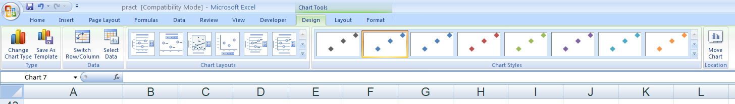
Chart Tools: Design
Pick the layout that most closely resembles the way you would like your plot to look.
You will be able to modify/add to this layout in the next step.
Use Select Data to add more data, to change the name of the series, or to modify where the data comes from…
The chart can be an object in any worksheet within the workbook or it can be a worksheet of its own.

Slide 12
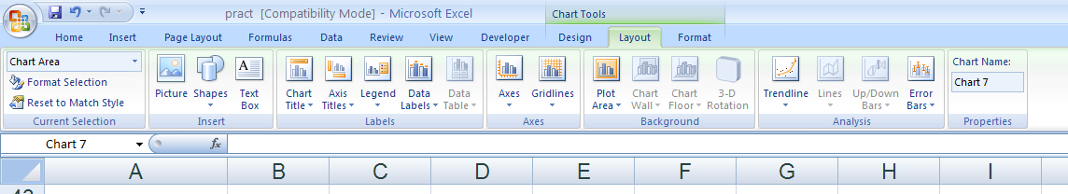
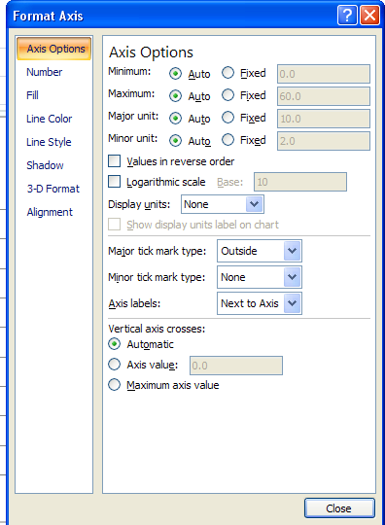
Chart Tools: Layout
The icons under the Labels heading allow you to change the way your Title, Axis Titles, Legend, and Data Labels look (formatting, line styles, etc.)
Format Axis allows you to change the maximum/minimum values on either Axis, change scale, where the axis crosses, etc. (see Axis Options pop up window to right)
You can also use this icon to change number formatting of values on axis, line style and color of axis, and alignment of values on axis

Slide 13
Chart Tools: Layout
Use Gridlines to change the appearance of gridlines, add more gridlines, or turn gridlines off
Add error bars to data
Modify the appearance of the Plot Area with this icon. You can change background color or change border colors/styles
Insert Trendlines or modify trend line options (show R² value, equation, etc.)

Slide 14
Placing graph on worksheet
Can be new sheet or object in sheet

Slide 15
Can edit existing graph
Click on graph to enter edit mode
Double click item in graph to be modified
Right click on graph
Select from chart toolbar
Example:
Select format axis to change to log scale

Slide 16
Multiple Curves on Same Plot
Select multiple columns or rows of data
Can also add additional data
Select chart->right click
Select source data

Slide 17
Types of graphs
Scatter graph
This is the ONLY type of 2D graph in Excel where the x-axis values are treated as actual numbers (so data points could be unevenly spaced)
Line graph
Use only if x data uniformly spaced
Pie chart
Column and bar graphs
Surface plot (3D)

Slide 18
Good Graphs:
Convey information clearly and neatly
Include Titles, Labels, Units…
Choose the right font size—it should be large enough to be read easily, but not too large that it distracts from the graph.
When you have more than one curve, make sure that each curve is clearly identified!
Some rules for good graphs:
http://www.rit.edu/cos/uphysics/graphing/graphingpart1.html

Slide 19
In Class Exercise #1
Enthalpy or heat content is a description of thermodynamic potential of a system, which can be used to calculate the "useful" work obtainable from a closed thermodynamic system under constant pressure
Entropy is a measure of the unavailability of a system’s energy to do work. High entropy → not much energy available to do work; Low entropy → maximum availability for conversion into work
http://en.wikipedia.org/wiki/Enthalpy
http://en.wikipedia.org/wiki/Entropy

Slide 20
In Class Exercise #1 (cont.)
Enthalpy and entropy data for saturated steam between 100 and 300°C
Make a plot with Temperature on x-axis, Enthalpy on y-axis, and Entropy on secondary y-axis
Make the plot a separate tab in your workbook
Reference: Sontag, et al., Fundamentals of Thermodynamics, 1998
Temp | Enthalpy | Entropy
ºC | KJ/kg | KJ/Kg-K
100 | 2676.05 | 7.3548
125 | 2713.46 | 7.0774
150 | 2746.44 | 6.8378
175 | 2773.58 | 6.6256
200 | 2793.18 | 6.4322
225 | 2803.27 | 6.2502
250 | 2801.52 | 6.0729
275 | 2784.97 | 5.8937
300 | 2748.94 | 5.7044

Slide 21

In Class Exercise #2
Using non-linear (log) axes can be useful when data covers a large range of magnitudes
Plot the friction coefficient for laminar fluid flow in round pipe
Create plot for values of Re of 1, 2, 5, 10, 20, 50, 100, 200, 500, 1000, 2000, 5000, 10 000, 20 000, 50 000, 100 000
$$C_{f}=\frac{5}{\sqrt{Re}}$$

Slide 22
In Class Exercise #3
Create an ordinary line graph* and also a log-log graph of the area (A) and volume (V) of a sphere as a function of the radius within the interval 0.01 ≤ R ≤ 10.
A = 4 π R2 and V = 4/3 π R3
For a log-log graph, make sure the data starts with some small positive number instead of 0.
Try to understand how to read the slope on a log-log graph and what it is related to in the formula.
* “ordinary line graph” = x-y scatter plot!

Slide 23
In Class Exercise #4
Make a chart that shows multiple plots of the monthly variation of Lake Ontario's water level in meters for each of the years. Make sure you have a title, axes labels, legend etc. such that it is well defined and clear.
What kind of plot works best for this?
In which year was the highest water level recorded?
Year | Jan | Feb | Mar | Apr | May | Jun | Jul | Aug | Sep | Oct | Nov | Dec
2000 | 74.5 | 74.45 | 74.58 | 74.82 | 75.1 | 75.26 | 75.24 | 75.06 | 74.81 | 74.61 | 74.46 | 74.47
2001 | 74.49 | 74.55 | 74.65 | 74.84 | 74.93 | 74.99 | 74.97 | 74.82 | 74.63 | 74.53 | 74.47 | 74.52
2002 | 74.56 | 74.68 | 74.79 | 74.98 | 75.22 | 75.33 | 75.19 | 74.91 | 74.65 | 74.49 | 74.36 | 74.37
2003 | 74.33 | 74.29 | 74.35 | 74.73 | 74.95 | 75.12 | 75.05 | 74.99 | 74.75 | 74.63 | 74.64 | 74.73
2004 | 74.83 | 74.75 | 74.72 | 74.89 | 75.04 | 75.14 | 75.09 | 75.02 | 74.95 | 74.7 | 74.5 | 74.55
2005 | 74.75 | 74.86 | 74.85 | 75.04 | 75.12 | 75.03 | 74.95 | 74.8 | 74.7 | 74.61 | 74.59 | 74.56
2006 | 74.63 | 74.86 | 74.82 | 74.83 | 74.84 | 74.89 | 74.98 | 74.95 | 74.81 | 74.74 | 74.79 | 74.83

Slide 24


In-Class Exercise #5
Scatter plots in Excel are very powerful and can plot curves much more complicated than the simple curves we’ve seen so far…
Plot the “Archimedes’ Spiral” using an x-y Scatter Plot
Using parameters a=0 & b=1, set up a table to compute the x- & y-coordinates needed to plot this curve for 0 ≤ θ ≤ 4π
$$r=a+bθ$$
$$x=r\cos{θ} \\ y=r\sin{θ}$$

